Slide 1

Superhero U:
Campaign Analysis
0408 DVT Group 16

Slide 2
Team Introduction
Ali Ahsan
Team Lead
Analysis and Planning
Data Preprocessing
Gundeti Sai Abhinav
Documentation
Shahith Rabeek
Data Visualization
David Solomon
Analysis and Planning
Mithila Rahman
Data Visualization
Syed Abdullah Bin Ali
Data Visualization
Fahim Faysal Sabir
Documentation
Samuel Welbeck
Data Preprocessing
Data Visualization
Tashinga Ncube
Documentation

Slide 3

Superhero U
Goal: Inspire innovation and inventiveness among youth
Focus: Empower imaginative minds to apply skills and creativity
Inspiration: Guided by the UN mission to “promote prosperity while protecting the planet”
Format: Competitive event for young talents
Impact: Equal and encouraging educational opportunities

Slide 4

Facebook Ads
The type of ad that GlobalShala used is a basic image ad, also known as a “Link Click” ad
GlobalShala placed ads targeting two different audiences, “students” and “educators and principals.

Slide 5
Superhero U Ad Campaigns 1/2
Campaign ID | Campaign Name | Geography | Audience
Campaign 1 | SHU_6 | Area 1 | Educators and Principals
Campaign 2 | SHU_3 | Area 2 | Students
Campaign 3 | SHU_Students (Australia) | Australia | Students
Campaign 4 | SHU_Students (Canada) | Canada | Students
Campaign 5 | SHU_Students (Ghana) | Ghana | Students
Area 1: Australia, Canada, United Kingdom, Ghana, Nigeria, Pakistan, United States
Area 2: Australia, Canada, United Kingdom, Ghana, Niger, Nigeria, Nepal, Pakistan, Thailand, Taiwan

Slide 6
Superhero U Ad Campaigns 2/2
Campaign ID | Campaign Name | Geography | Audience
Campaign 6 | SHU_Students (India) | India | Students
Campaign 7 | SHU_Students (Nepal) | Nepal | Students
Campaign 8 | SHU_Students (Nigeria) | Nigeria | Students
Campaign 9 | SHU_Students (UAE) | UAE | Students
Campaign 10 | SHU_Students (UK) | UK | Students
Campaign 11 | SHU_Students (USA) | USA | Students

Slide 7
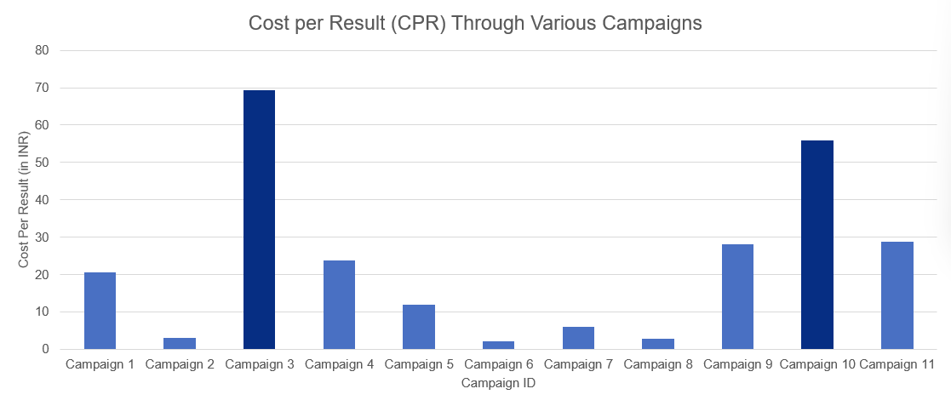
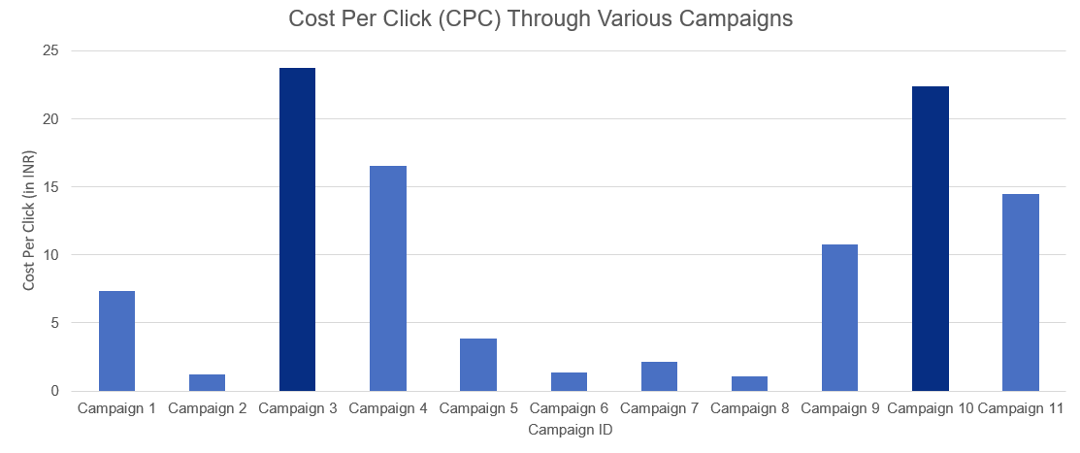
Campaign Discontinuation
CPC and CPR are ratios of the Cost for campaign to Clicks and Results respectively
Result in this case is referred to the unique click-through to get to the Superhero U website
Campaigns 3 and 10 hold the highest values for Cost per Result (CPR)
Campaigns 3 and 10 also hold the highest values for Cost per Click (CPC)

Slide 8
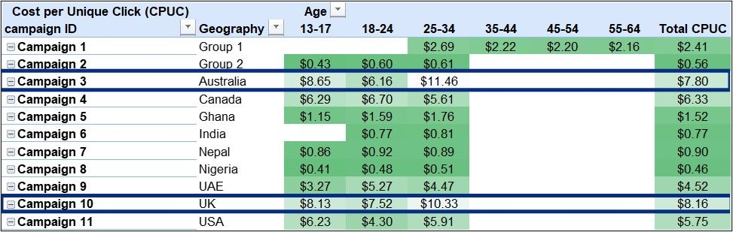
Campaign 3 and 10 have the highest values in terms of Cost per Unique Click of all age groups
Cost in this context is the amount spent on the campaign

Slide 9
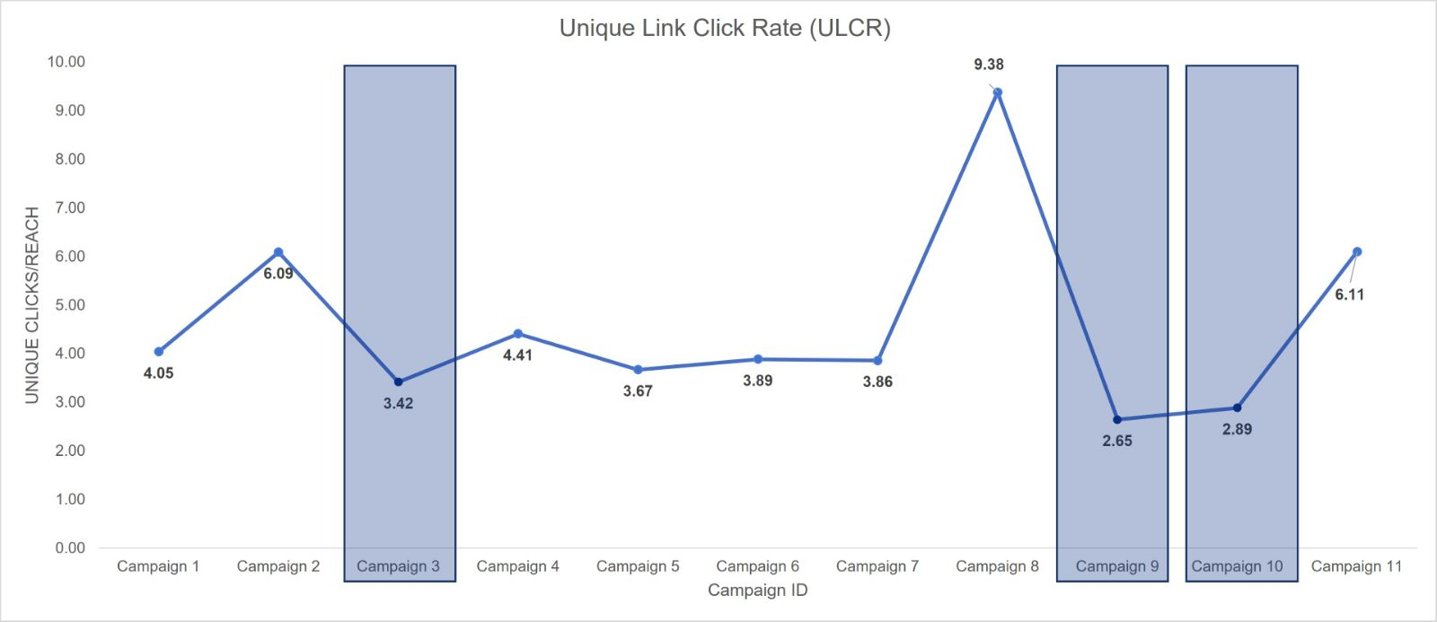
Campaigns 3, 9 and 10 have the lowest values for Unique Link Click Rate (ULCR)
ULCR here refers to total number of unique link clicks / total number of impressions

Slide 10
Conclusion
Worst Performance
Campaigns
3 and 10
Best Performance
Campaigns
2, 6 and 8
Campaign 9 also performed relatively poor in terms of overall impression metrics. However, since it proved to be cost effective, campaign 9 is allowed to operate

